Slide 1

Scientifc Paper Discovery using arXiv – Deva H
Hugging face : https://huggingface.co/spaces/Devaharibabu/Arxiv_RAG_Scientific_Paper_Discovery

Slide 2
1. Introduction
Welcome to Scientific Paper Discovery (RAG + Evaluation)! 🚀 This tool lets users enter any research topic and fetch relevant, real-time scientific papers from arXiv. It uses a Retrieval-Augmented Generation (RAG) pipeline to answer questions and summarize content from the papers. Built with: - 🔎 ArXiv API for live paper fetching - 🧠 RAG using Transformers - 📊 Evaluation of summary & retrieval quality - 🧑‍💻 Gradio UI for a friendly interface

Slide 3
2. Scope of the Project
- Research Topic Exploration: Users enter a topic or keyword to fetch relevant arXiv papers. - Real-Time Retrieval: Dynamically pulls the latest papers using the arXiv API. - Summarization & Answer Generation: Summarizes insights from retrieved papers. - Quality Evaluation: Evaluates summary relevance and accuracy. - No-Code Interface: Gradio UI for easy use. - Extensible: Can be expanded to other scholarly APIs or domain-specific filters. This acts as a smart assistant for faster literature review and research discovery.

Slide 4
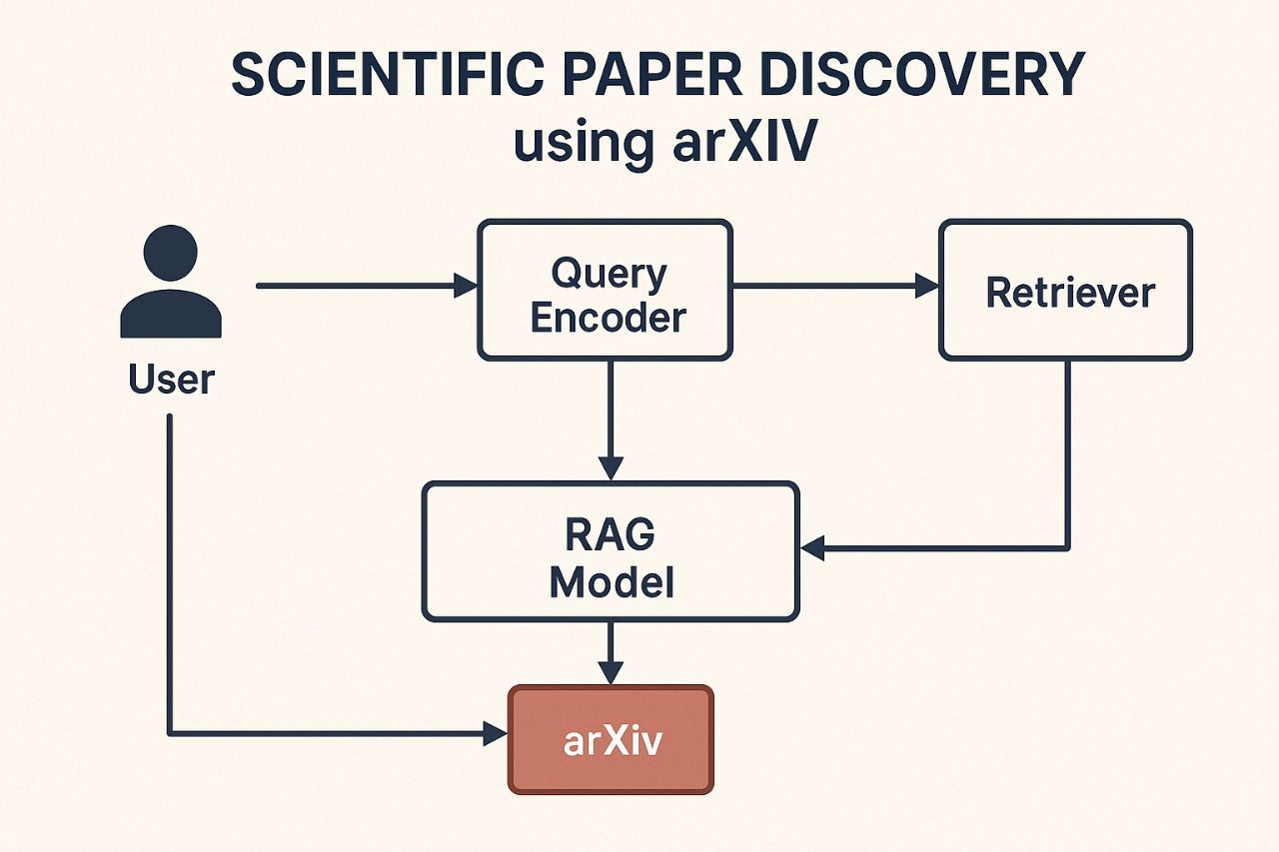
3. System Architecture Diagram Below is a conceptual diagram of the system architecture used:

Slide 5
4. Modules Explanation
1. User Interface Module (Gradio): Accepts research topic input and displays results. 2. ArxivLoader: Fetches the most recent papers based on user query. 3. Embedding & Retrieval Module: Embeds abstracts using sentence-transformers, then finds relevant papers. 4. RAG Model Pipeline: Performs question answering and summarization from the retrieved data. 5. Evaluation Module: Uses similarity metrics to assess summary and retrieval quality.

Slide 6
5. Sample Outputs
Example: Entering query 'quantum computing' returns latest arXiv papers and generates a summary. It also answers custom questions like 'What are the latest methods in quantum computing?'

Slide 7
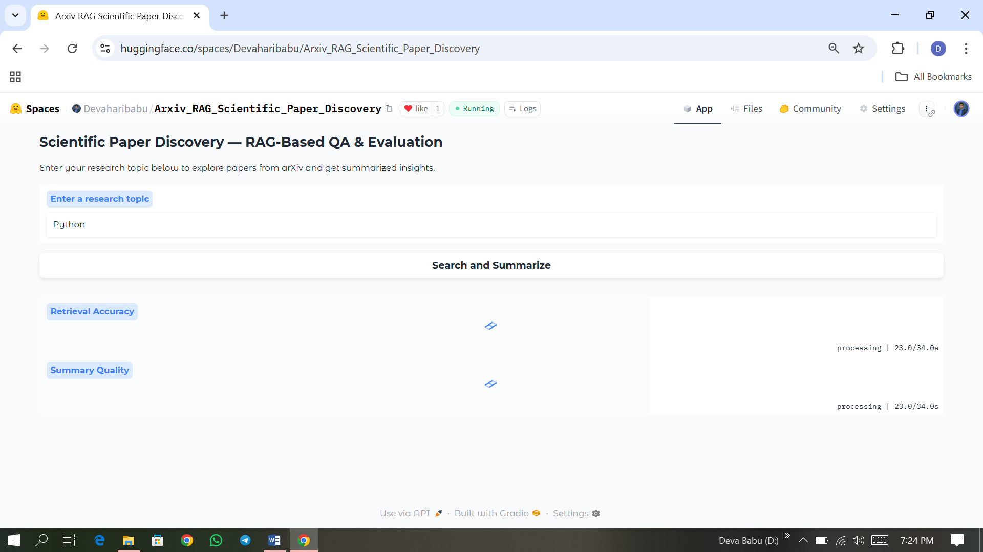
6.(a) Sample Output page [i]

Slide 8
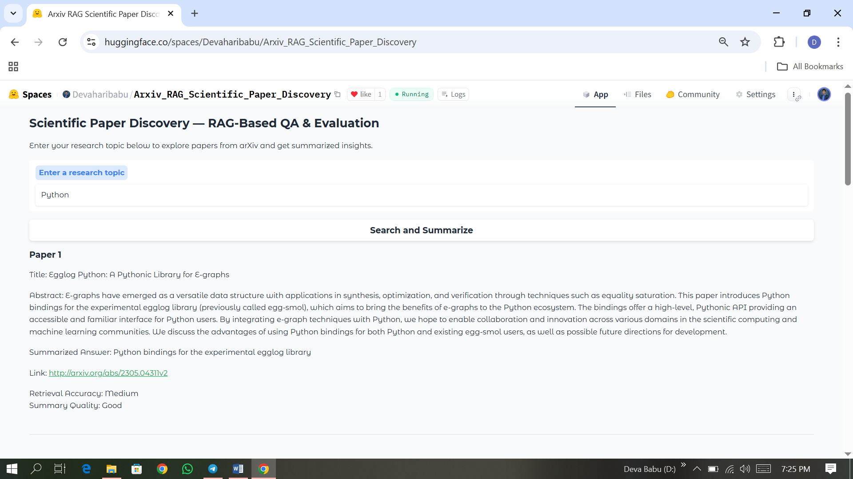
6.(a) Sample Output page [ii]

Slide 9
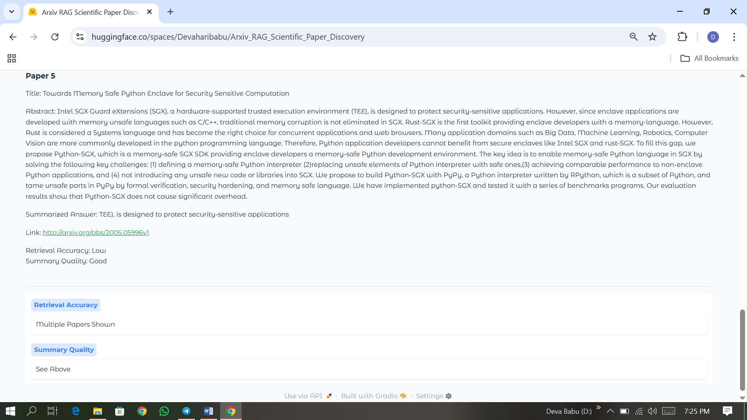
6.(a) Sample Output page [iii]

Slide 10
7. Conclusion
This project delivers a powerful and user-friendly platform for discovering, retrieving, and understanding scientific papers from arXiv using Retrieval-Augmented Generation (RAG). With live fetching, summarization, and evaluation — it simplifies the literature review process and empowers researchers with quick, insightful overviews.

Slide 11
8. References
- arXiv API: https://arxiv.org/help/api - Hugging Face Transformers: https://huggingface.co/transformers - Gradio: https://www.gradio.app - Sentence-Transformers: https://www.sbert.net/

